Slide 1
CASE STUDY ANALYSIS 2
Positioning the Connector 2001
– By Group 3
Evan D, Thanvitha K, Jeevan Gowda, Nanditha K, Adrian Vasquez

Slide 2
Introduction
The Connector, a newly created handheld gadget from Netlink Inc. that combines wireless technology with PDA features, is soon to be released.
Netlink's first significant product would be the Connector, model version 10L.
Even though Netlink's management is optimistic about Connector, they are still unsure about the ideal positioning and market for their new products

Slide 3
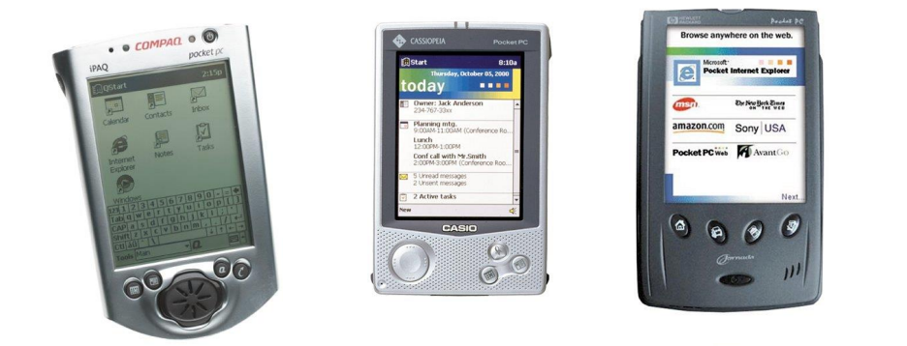
Sample of PDA Market
(left to right Compaq ipaq, Casio Casiopea, HP Pocket PC)
Notes:
Personal digital assistants - help people manage their contacts, emails, and could access certain web pages through the internet

Slide 4
Background
The planned Connector 10L model will have the following features:
True wireless connectivity,
the ability to instantly send and receive voice and data at any time (including for usage as a cell phone, e-mail, etc.),
Voice-recognition software and voice-recording equipment.
Monochrome, lighted display.
Notes:
Netlink hopes that with the introduction of its Connector wireless access will rise above mere geek appeal. The planned Connector 10L model will have the following features:
True wireless connectivity, or the ability to instantly send and receive voice and data at any time (including for usage as a cell phone, e-mail, etc.),
Voice-recognition software and voice-recording equipment.
Monochrome, lighted display; $20 will get you a clip-on that fastens to the monitor and makes the display larger.

Slide 5
Question 1
NETLINK Conducted a Study amongst 50 potential customers
Connector's target market described as cellular phone users with a need for instant data transfer.
Measured their preferences amongst a variety of important attributes

Slide 6
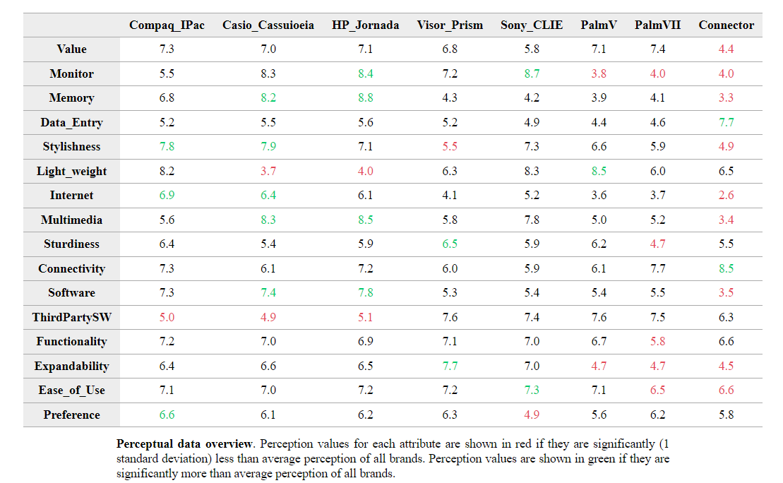
Question 1

Slide 7
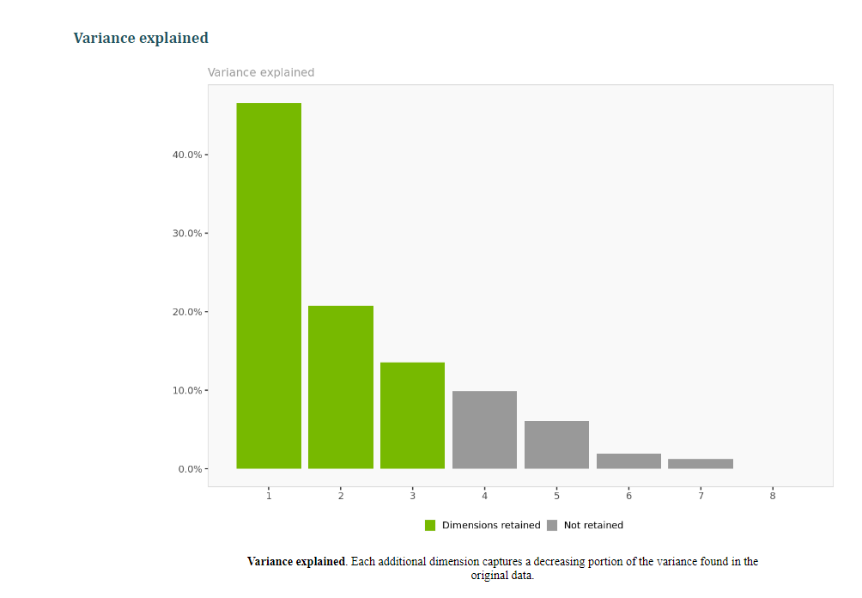
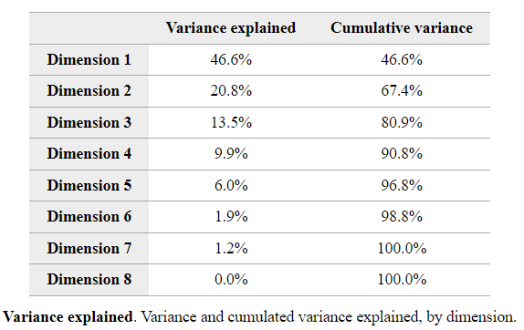
Dimension Creation

Slide 8
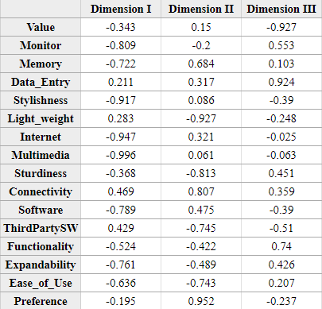
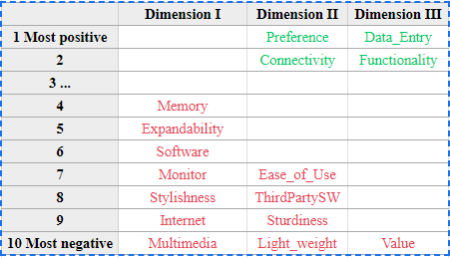
Question 1

Slide 9
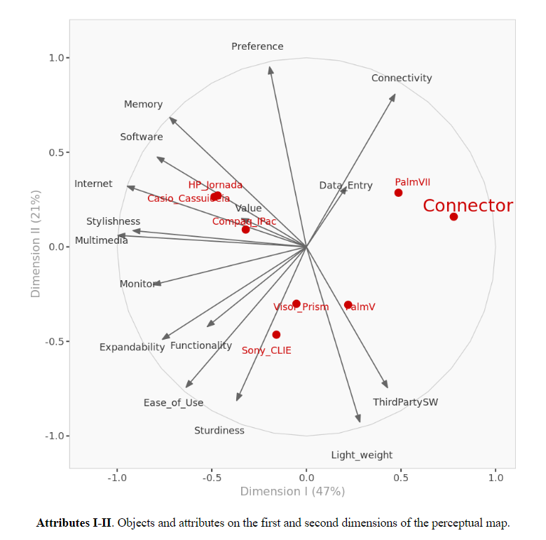
Question 1

Slide 10
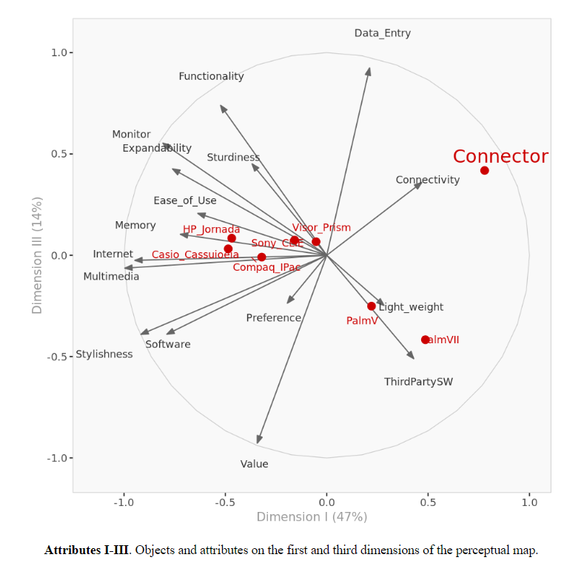
Question 1

Slide 11
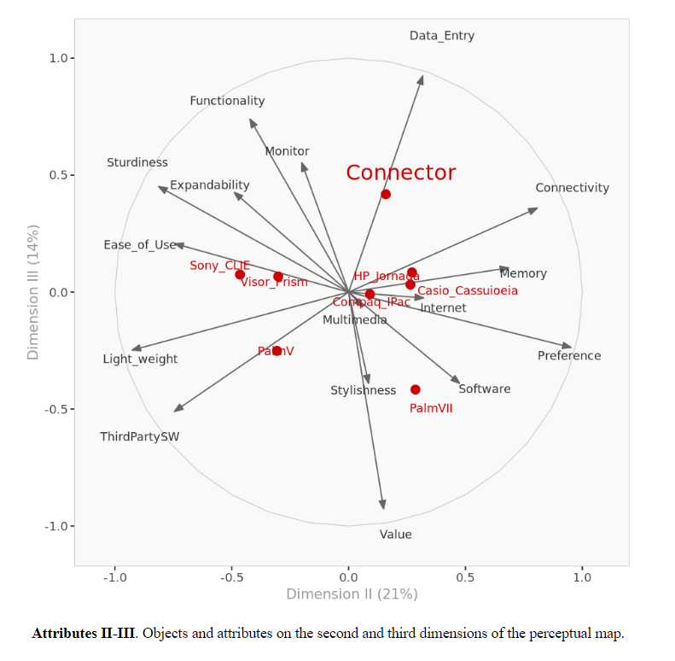
Question 1

Slide 12
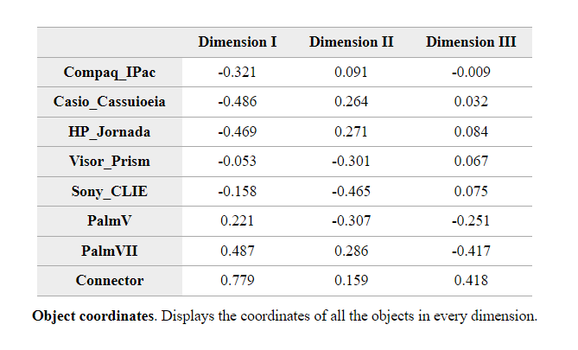
Question 1

Slide 13
Question 2
Marketing Claim: “Connector as a sleek handheld device for people always on the go, which is a better valued alternative to other wireless PDAs in the market, as it supposedly also relieves its owner of the need for an additional cellular phone”
Notes:
I believe this is a decent strategy for Netlink Connector 10L because the Palm v3 is the only other pda that allows the wireless capability of voice and data connection. However they are negatively correlated with style so it might be a good strategy to improve that in the eye of the consumers because many customers value style as an important attribute. Also they are pretty much uncorrelated with value, probably because people see little value in buying a cell phone and a wireless PDA. Thus, I think they need to capitalize on its ability to integrate data and cell phone technology as one. I would market it as an upgraded Cell Phone service, that would also increase their value perception which they are uncorrelated with. Thus, the connector could be marketed as a cell phone that has more value. Also they might be able to curb some customers who have or are interested in buy a phone but think it too expensive.

Slide 14
Question 2
Marketing Claim: “Connector as a sleek handheld device for people always on the go, which is a better valued alternative to other wireless PDAs in the market, as it supposedly also relieves its owner of the need for an additional cellular phone”
Relevant variables:
Stylishness Light _weight Connectivity Value
Notes:
I believe this is a decent strategy for Netlink Connector 10L because the Palm v3 is the only other pda that allows the wireless capability of voice and data connection. However they are negatively correlated with style so it might be a good strategy to improve that in the eye of the consumers because many customers value style as an important attribute. Also they are pretty much uncorrelated with value, probably because people see little value in buying a cell phone and a wireless PDA. Thus, I think they need to capitalize on its ability to integrate data and cell phone technology as one. I would market it as an upgraded Cell Phone service, that would also increase their value perception which they are uncorrelated with. Thus, the connector could be marketed as a cell phone that has more value. Also they might be able to curb some customers who have or are interested in buy a phone but think it too expensive.

Slide 15
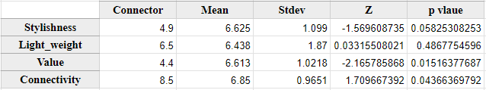
Question 2
How does the Connector 10L Measure on these Variables?
Notes:
I believe this is a decent strategy for Netlink Connector 10L because the Palm v3 is the only other pda that allows the wireless capability of voice and data connection. However they are negatively correlated with style so it might be a good strategy to improve that in the eye of the consumers because many customers value style as an important attribute. Also they are pretty much uncorrelated with value, probably because people see little value in buying a cell phone and a wireless PDA. Thus, I think they need to capitalize on its ability to integrate data and cell phone technology as one. I would market it as an upgraded Cell Phone service, that would also increase their value perception which they are uncorrelated with. Thus, the connector could be marketed as a cell phone that has more value. Also they might be able to curb some customers who have or are interested in buy a phone but think it too expensive.

Slide 16
Question 2
Is the marketing statement a valid claim?
Somewhat…
The Connector fails to deliver on 2/4 claims.
Delivers well on Connectivity
Notes:
I believe this is a decent strategy for Netlink Connector 10L because the Palm v3 is the only other pda that allows the wireless capability of voice and data connection. However they are negatively correlated with style so it might be a good strategy to improve that in the eye of the consumers because many customers value style as an important attribute. Also they are pretty much uncorrelated with value, probably because people see little value in buying a cell phone and a wireless PDA. Thus, I think they need to capitalize on its ability to integrate data and cell phone technology as one. I would market it as an upgraded Cell Phone service, that would also increase their value perception which they are uncorrelated with. Thus, the connector could be marketed as a cell phone that has more value. Also they might be able to curb some customers who have or are interested in buy a phone but think it too expensive.

Slide 17
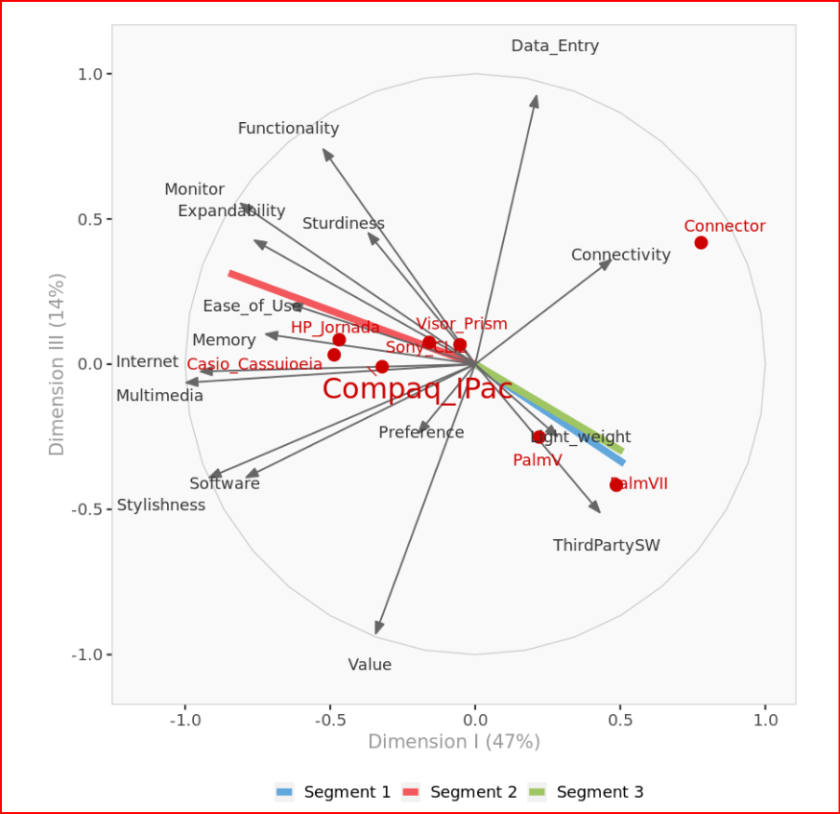
Question 3: Distinct Segments
Segment 1 third party, light weight
Segment 2 stylish, multimedia, software, memory, and internet
Segment 3 connectivity data entry
Notes:
Conector 10L is definitely closest to segment 3 but it seems like people only value it because of the data entry and connectivity, However, preference and value iis not far from segment 3 and I think it would be benefit if netlink market the connector as an upgraded cell phone, and could curn more customer based on preference, and value, since it would cost the same but you would get more features.

Slide 18
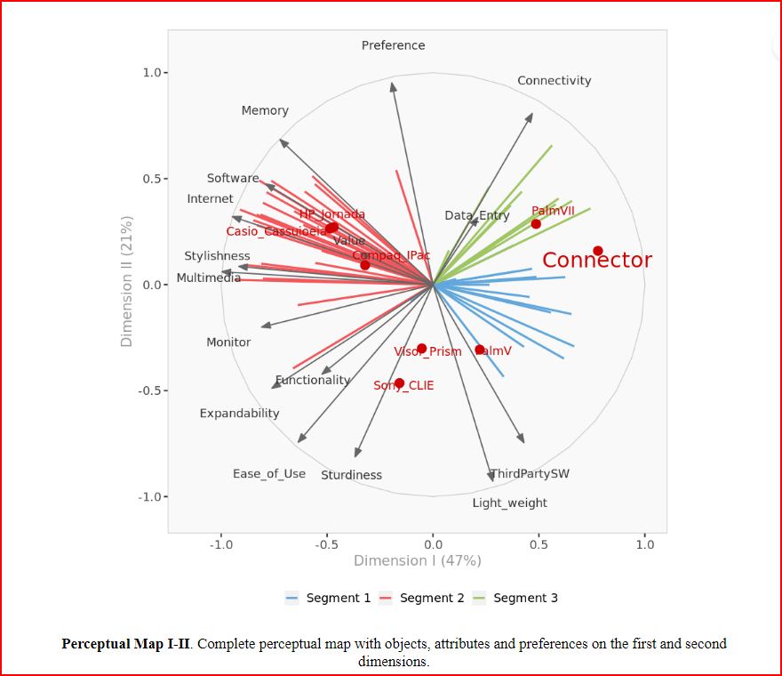
Question 3: Customer Preference
Memory
Stylishness
Internet
Multimedia
Monitor
Softwar
Notes:
Conector 10L is definitely closest to segment 3 but it seems like people only value it because of the data entry and connectivity, However, preference and value iis not far from segment 3 and I think it would be benefit if netlink market the connector as an upgraded cell phone, and could curn more customer based on preference, and value, since it would cost the same but you would get more features.

Slide 19
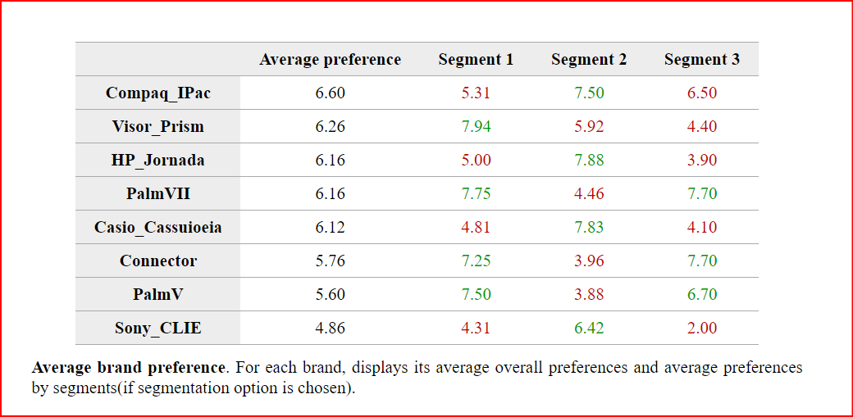

Slide 20
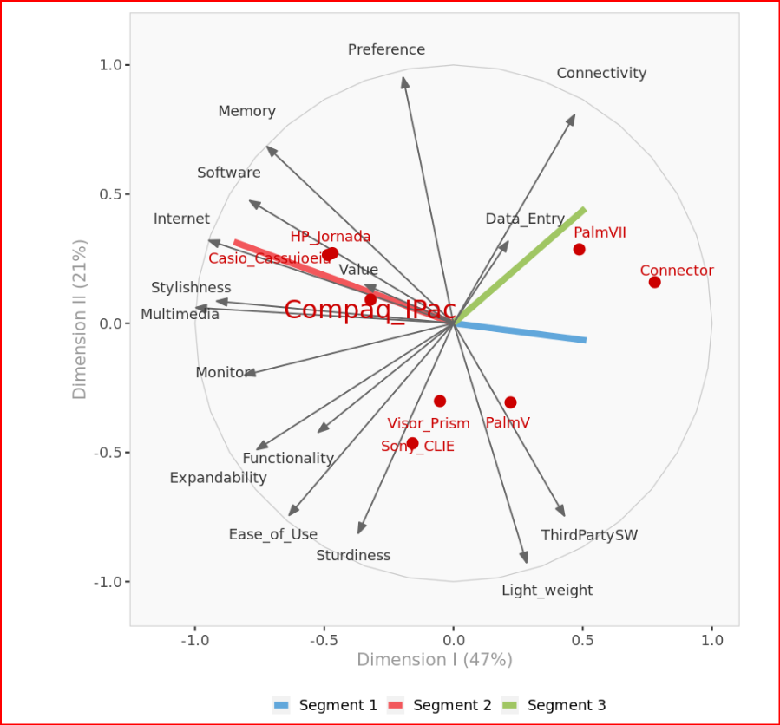
Heterogeneousness

Slide 21
Question 3:What Attributes Data would you like to see?
Email
Voice/celular
Customer service
Music
Voice Recognition
Price
Customer Demographics

Slide 22
Question 4: What are Recommended Position Changes:
value and preference
Option 1:
Leverage strengths and the fact it's different
Use Differentiation and focus strategy.
Improve value and preference which no competitor has a stronghold
Option 2 :
Churn Customers from competitors.
Try to strengthen its association with some of the more popular attributes that it is negatively correlated
Strengthen weakness to such as: internet access, increasing memory and making it more stylish
Notes:
Question 4: Are there any changes to the features of Connector model L1 (prototype) that should be considered?
Improve internet access, increasing memory and making it more stylish Because the majority of the customers surveyed put a lot of value in these attributes
Also the connector is not far from being associated with value and preference so it would not take as much work to strengthen that association.
.Also it could think about positioning itself as having internet access, increasing memory and making it more stylish. All three of those attributes will help them position themselves as more attractive to the market because those attributes are important to them.

Slide 23
Question 5
Connector's voice recognition program requires the user spend a long time training the software to recognize the individual's pronunciation and intonation. Therefore, the feature was demonstrated to the subjects by a Connector product developer using her own trained machine.
Was the demonstration helpful?

Slide 24
Question 5
Yes

Slide 25
Question 6
Possible potential research opportunities:
How to include multimedia access.
More Demographics data
Perform Conjoint analysis to determine what features to include.
What geographic areas have and are building network availability.

Slide 26
Question 7
ADVANTAGES
Automated calculations: Long and rigorous calculations run nearly instantaneously.
Limited technical knowledge required: the prepackaged analysis requires little to no technical knowledge of the underlying methodologies
Minimal computational power required: Runs in a web browser, no proprietary software required
Automated report generation: The software returns an automated report which covers most needs in analysis of positioning.

Slide 27
Question 7
LIMITATIONS
Limits to size of data sets: data sets are limited to dozens of records and attributes, making it far too small for larger more complex data sets.
Minimal customization in reports: As reports are templated, there is little in the way of customization of the reports sections visuals or commentary.
Lack of customization in analysis: The software provides minimal customization for more complex analysis. (ie. 80% Cum. Var lock)

Slide 28
Summary
Define Segment
Understand Customer Preference
Identify Connectors strengths and weaknesses
Segment 1: third party, light weight
Segment 2: stylish, multimedia, software, memory, and internet
Segment 3: connectivity, data entry

Slide 29
Summary
Conector strengths:
Connectivity
Data entry
Conector Weakness:
Memory,
Stylishness
Internet
Multimedia
Monitor
Software
Customer preferences

